Slide 1
影片敘述之自動生成 Video caption generation
吳克駿、江昶翰

Slide 2
Outline
Repeoduce “Sequence to sequence- Video to Text”
Reading “Attention Mechanism” paper

Slide 3
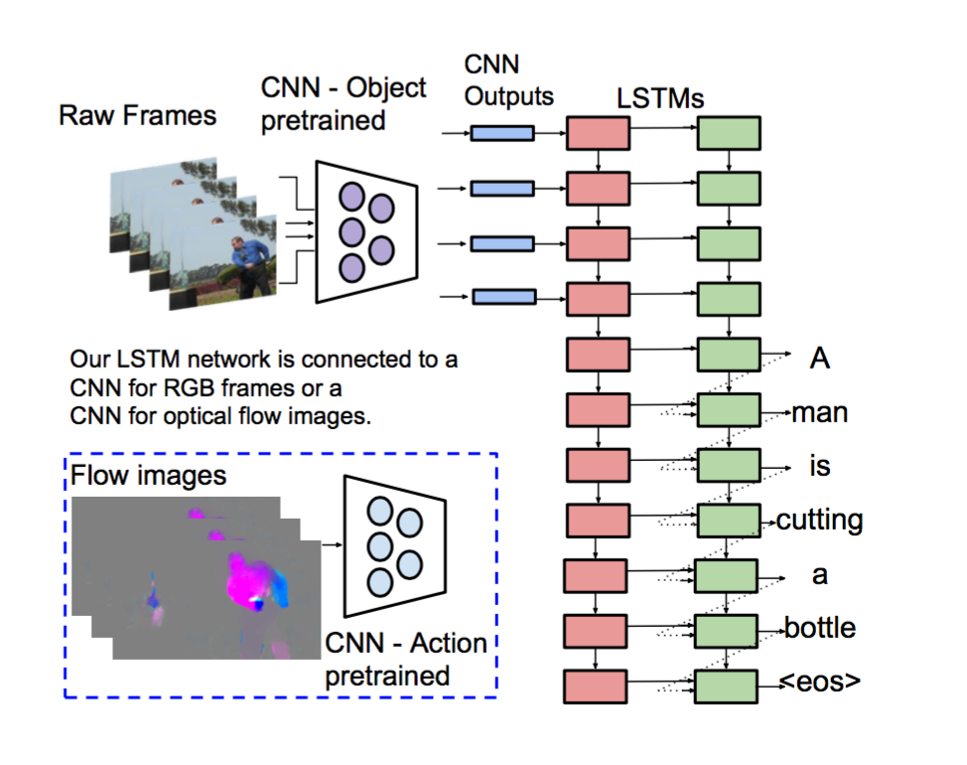
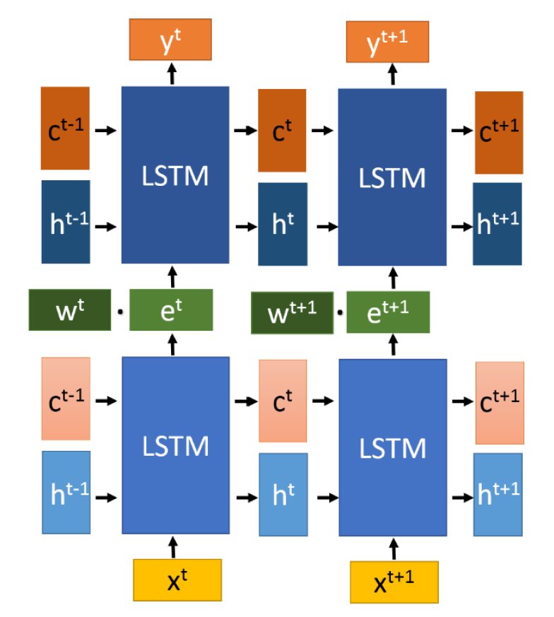
Model flowchart

Slide 4
Weight matrix(128,20) Bias(20)
Using softmax-cross-entropy
LSTM2(output words)
[Encoding]
input the information of LSTM1 only
[Decoding]
input the word embedding and LSTM1’s info
output info for predicting
Hidden Layer
concatenate word embedding and output of LSTM1
LSTM1(input frames)
[Encoding]
input latent vector of image
[Decoding]
input padding
output information based on memory
Weight matrix(4096,128) Bias(128d)
Input:image features(4096d)

Slide 5
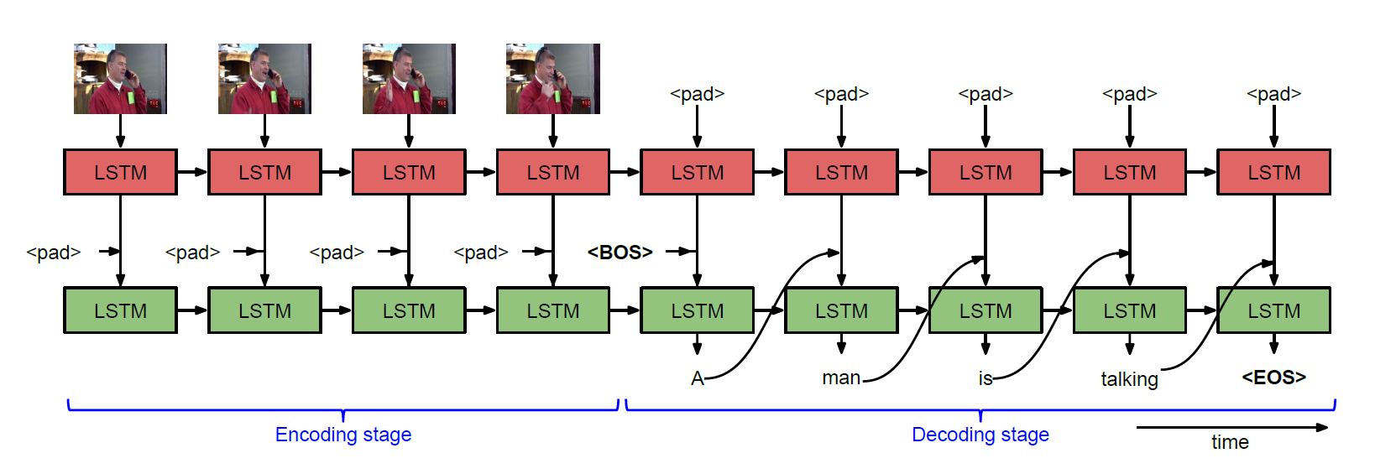
Weight matrix(128,20) Bias(20)
Using softmax-cross-entropy
LSTM2(output words)
[Encoding]
input the information of LSTM1 only
[Decoding]
input the word embedding and LSTM1’s info
output info for predicting
Hidden Layer
concatenate word embedding and output of LSTM1
LSTM1(input frames)
[Encoding]
input latent vector of image
[Decoding]
input padding
output information based on memory
Weight matrix(4096,128) Bias(128d)
Input:image features(4096d)

Slide 6
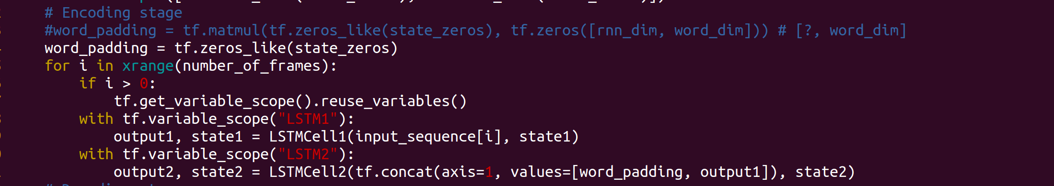
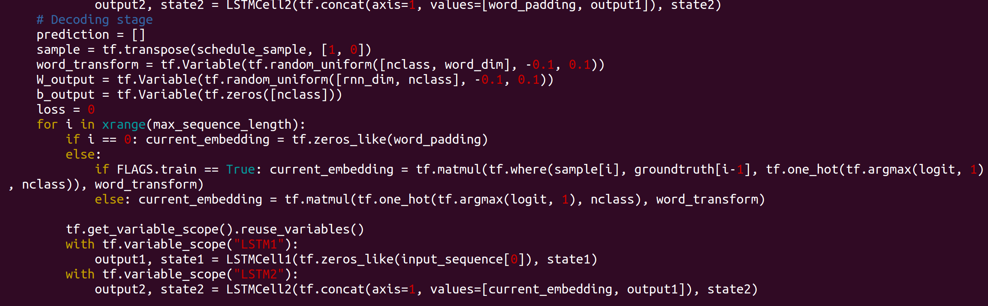
Encoding
Decoding

Slide 7
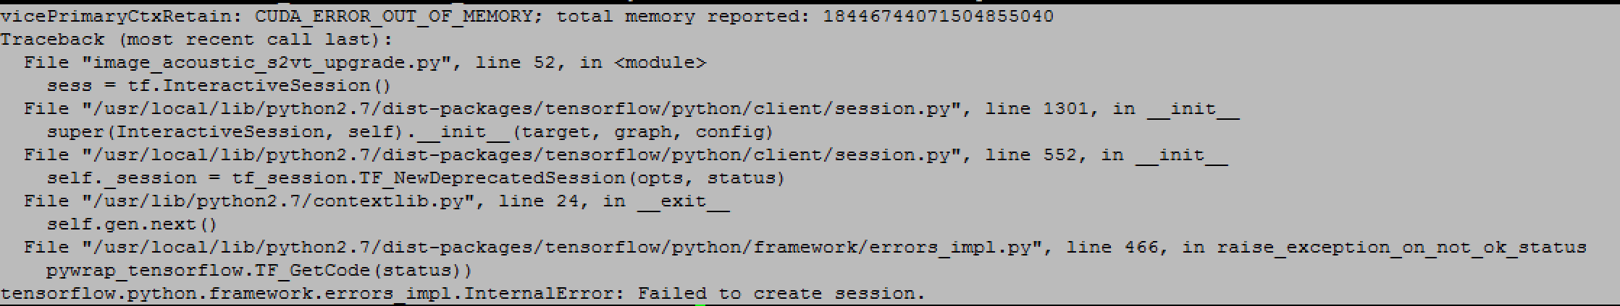
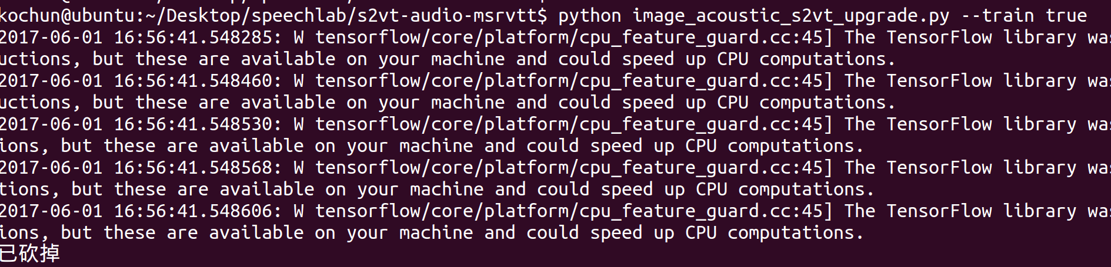
Limit : out-of-memory

Slide 8
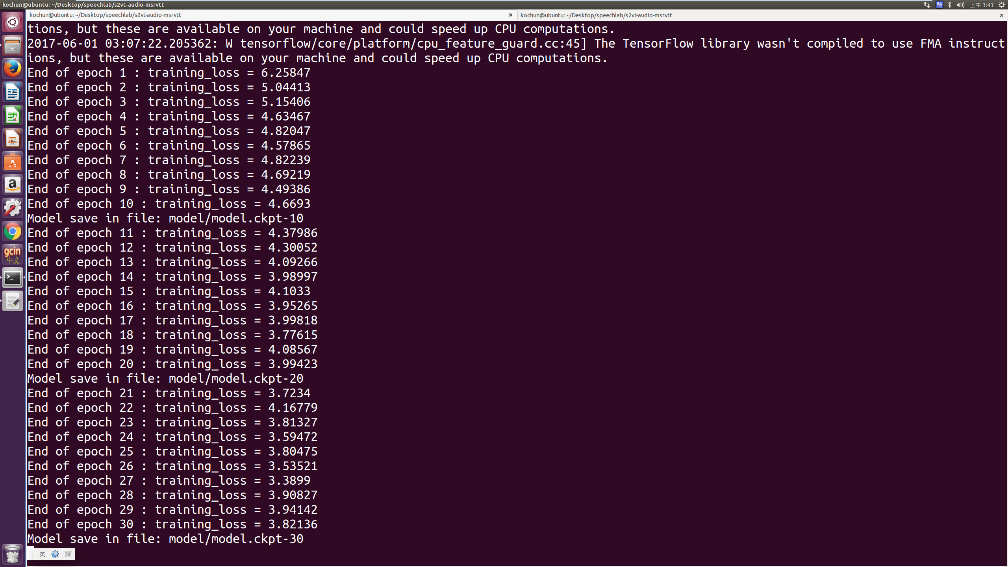
Training…..

Slide 9
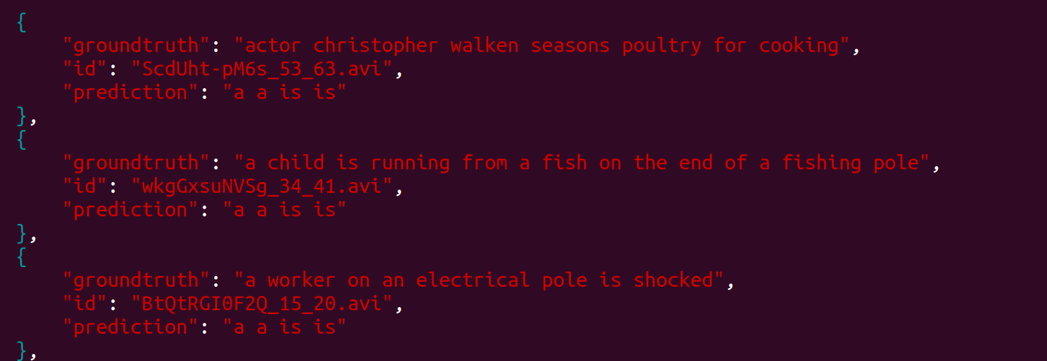
When Epoch = 10

Slide 10
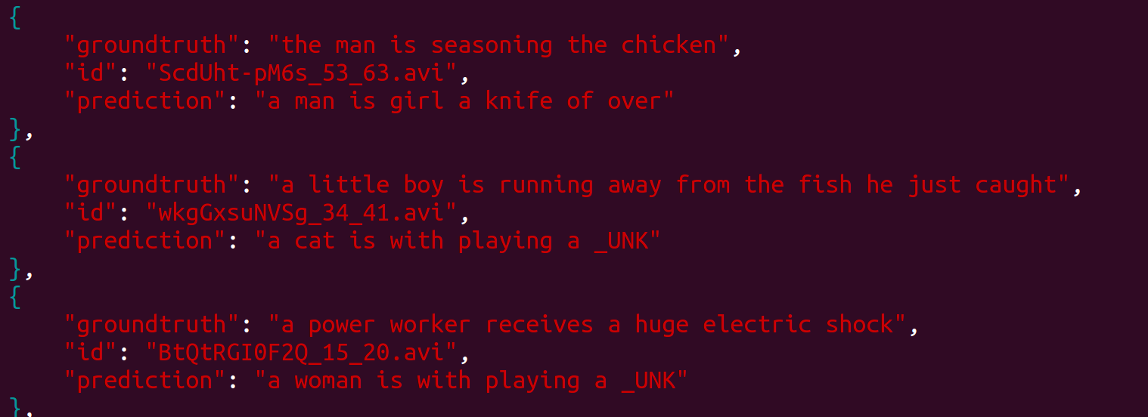
When Epoch = 100

Slide 11
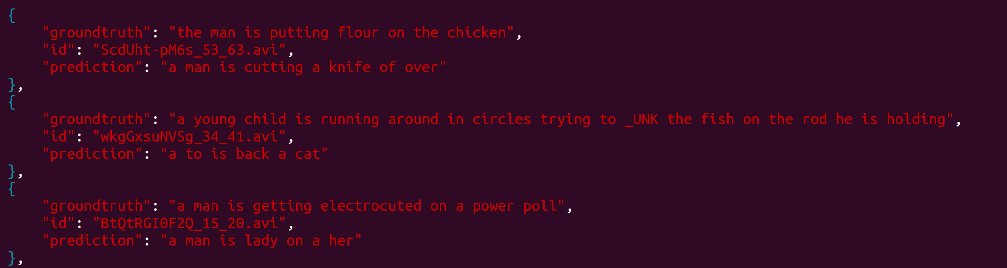
When Epoch = 300

Slide 12
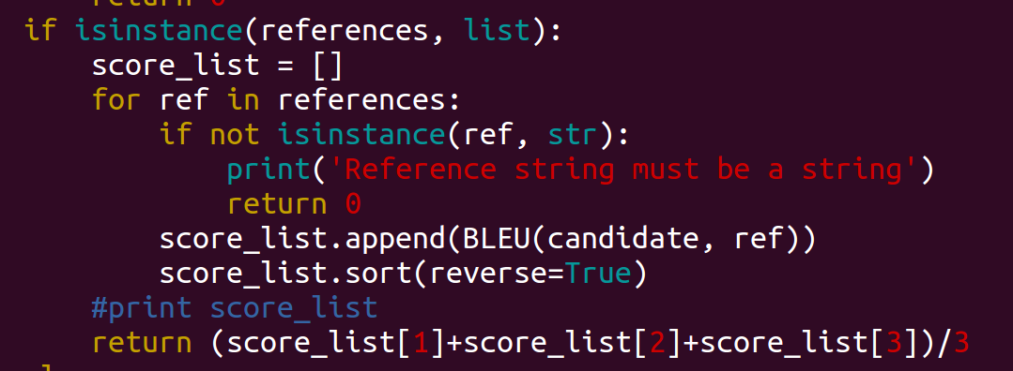
Evaluate by BLEU
Method: Choose 3 highest score between prediction and captions of same video
Result:

Slide 13
Using Smaller parameters
Recommand
Epoch:2000
LSTM dimension:256
Real
Epoch:300
LSTM dimension:128
Batch size:50

Slide 14
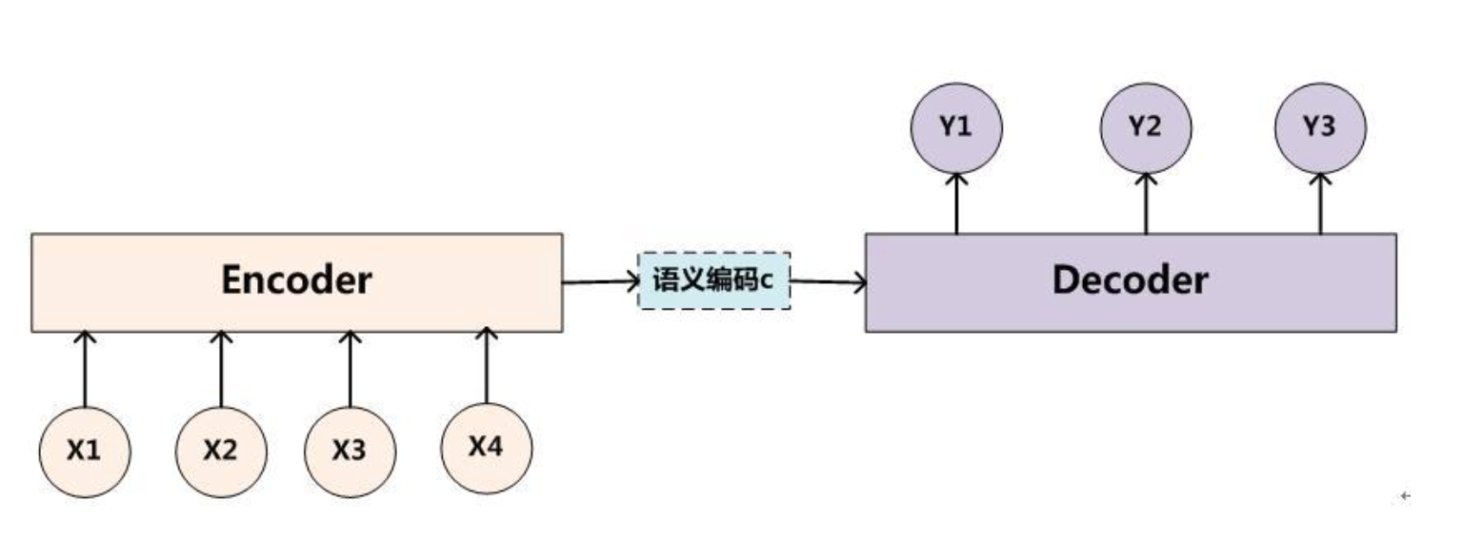
Seq2Seq
input : Sequence
output : Sequence
Encoder and decoder

Slide 15
Seq2Seq
limit: 固定長度
problem: 1.無法完全表示整個序列的資訊 2.先輸入的內容攜帶的資訊會被後輸入的資訊稀釋掉

Slide 16
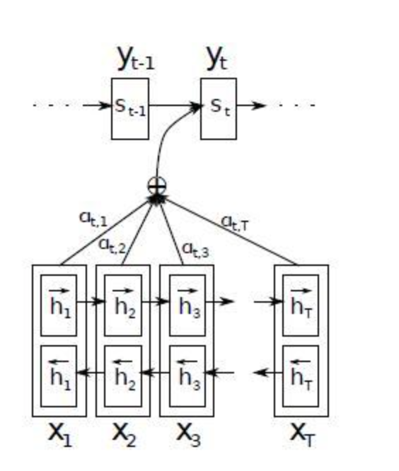
Attention

Slide 17
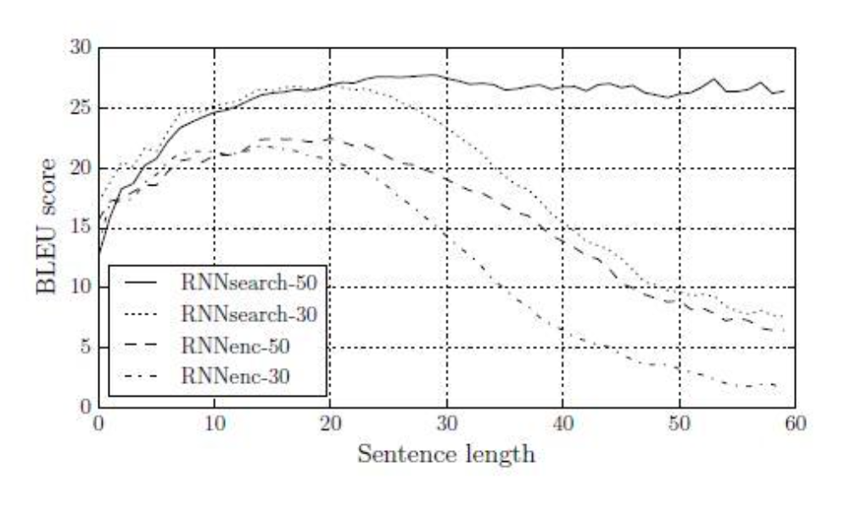
Experiment

Slide 18
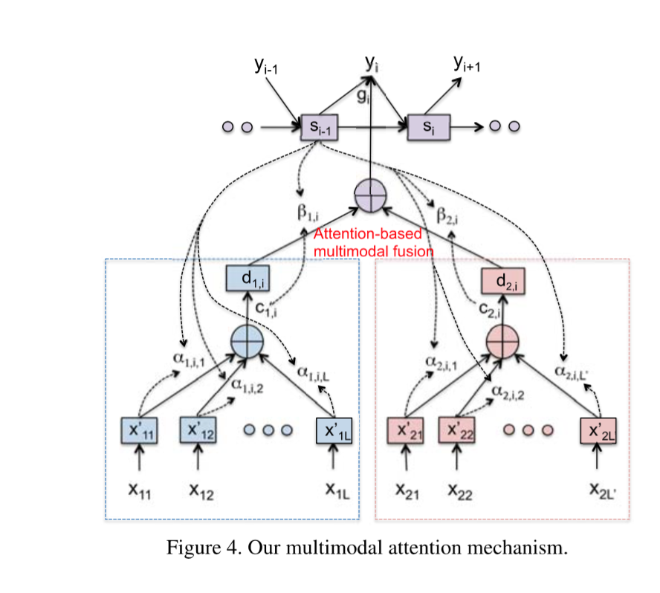
Attention

Slide 19
Todo
Add attention layer
Run with higher dimension, epoch, batch_size

